Slide 1
GRAMENER CASE STUDY
Sushma Subburayan
Swapnila Singh
Rohit Shankar
Prashant Singh Jadon

Slide 2
GRAMENER CASE STUDY
OBJECTIVE:
To identify the patterns which indicate if a person is likely to default, which may be used for taking actions such as denying the loan, reducing the amount of loan, lending loan to risky applicants at a higher interest rate, etc.
DATA :
Complete loan data for all loans issued through the time period 2007 t0 2011.
GOALS OF THE ANALYSIS:
To understand the driving factors behind loan default, so that he company can utilize this knowledge for its portfolio and risk assessment.

Slide 3
The following are purposes for which loans were taken.
Vacation
Small business
Debt consolidation
Credit card
Educational
Home improvement
Moving
Car
Major purchase
Renewable energy
Medical
Wedding
House
Other

Slide 4
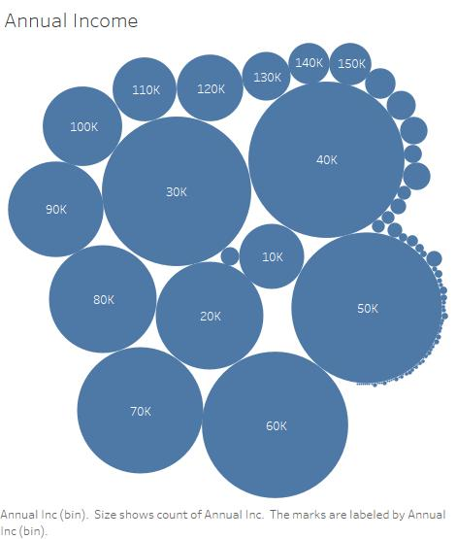
The annual income of the customers ranges from 4,000$ to 6,000,000$

Slide 5
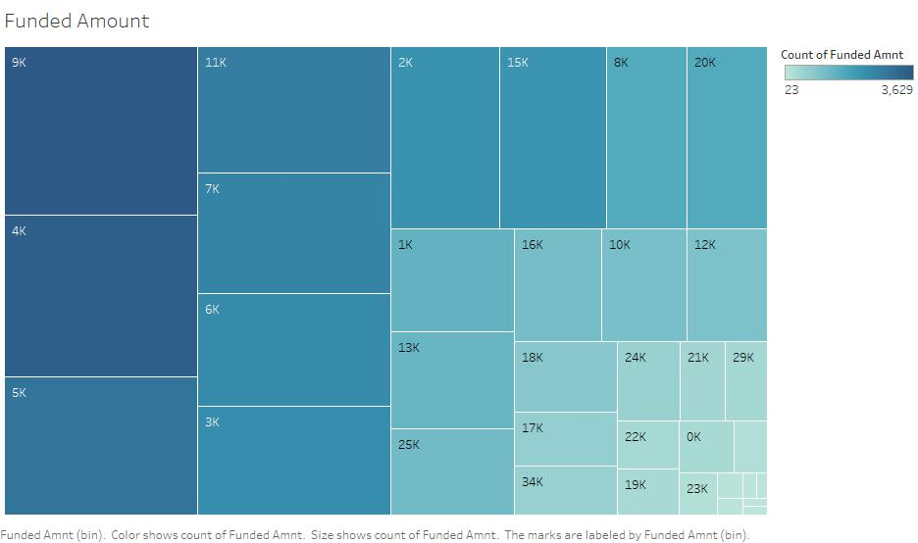
The funded amount ranges from 500$ to 35,000$

Slide 6
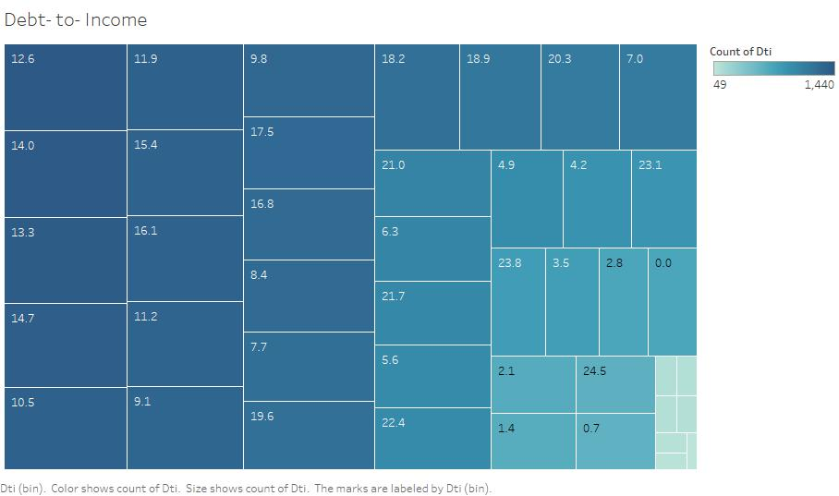
The debt-to-income ratio of the borrowers range from 0.00 to 29.99.

Slide 7
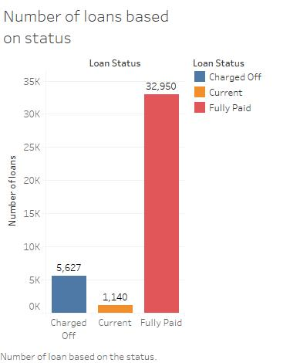
NUMBER OF LOANS BASED ON STATUS
Status of the loan can be
Fully paid
Current
Charged off
The number of loans fully paid
is 32,950.
The number of loans charged
off is 5,627, which is around
14.16% of the total loans
taken.

Slide 8
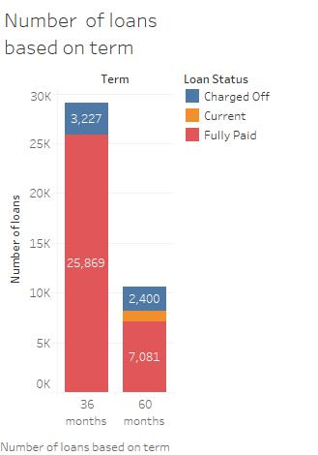
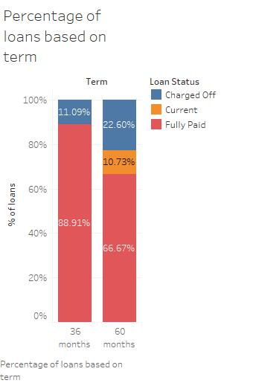
NUMBER OF LOANS BASED ON TERM
Term : There are two terms
36 months
60 months
It is evident from the
graph that the percentage
of loans charged off is high
In case of the loans with
60 months term

Slide 9
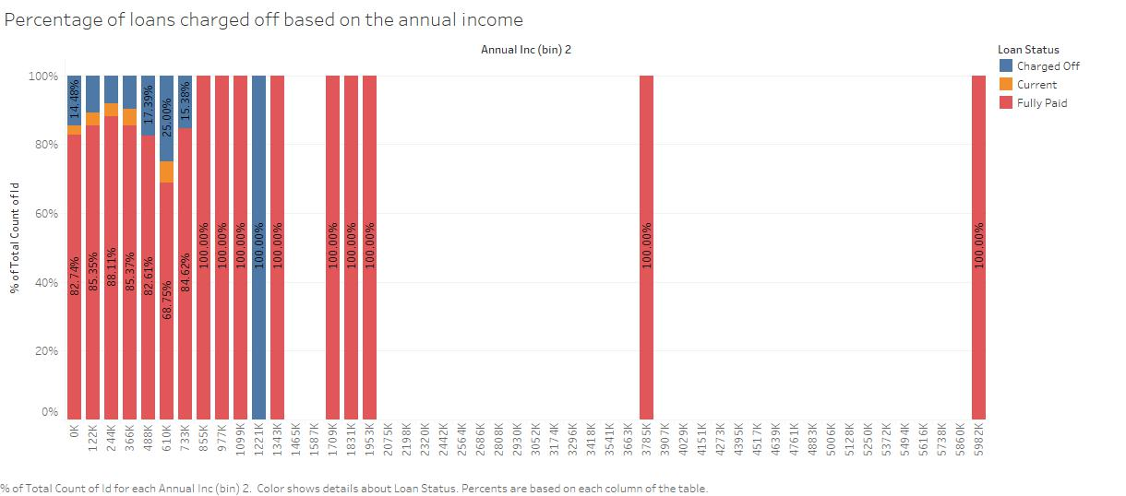
NUMBER OF LOANS BASED ON ANNUAL INCOME

Slide 10
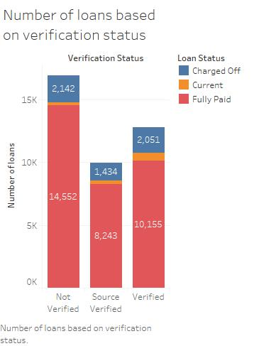
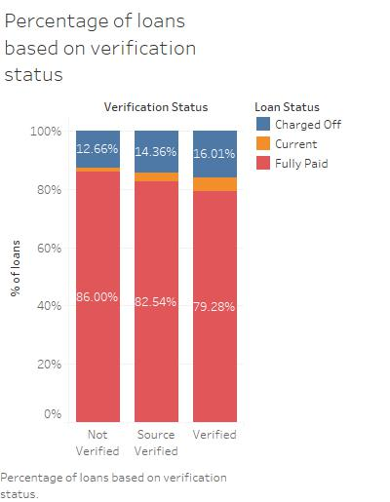
NUMBER OF LOANS BASED ON VERIFICATION STATUS
Verification Status: There
are three types of
verification status
Not Verified
Verified
Source Verified
There is no significant
impact because of
the verification as there
is a very slight difference
in the percentage
of loans charged
off because of the
verification status.

Slide 11
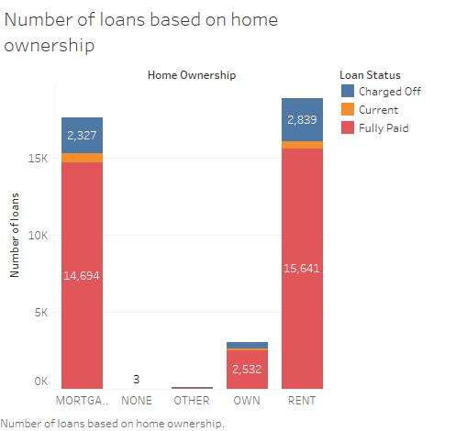
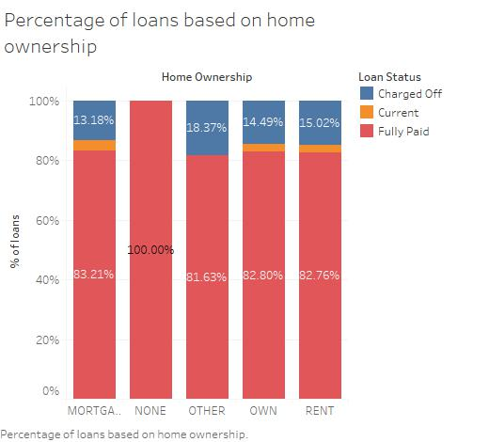
NUMBER OF LOANS BASED ON HOME OWNERSHIP
Length of employment of the customer ranges from
less than 1 year to 10 years.
The home ownership status of the borrowers can be
RENT
OWN
MORTGAGE
OTHER
There is no significant
impact because of
the home
ownership as there
is a very slight difference
in the percentage
of loans charged
off because of it.

Slide 12
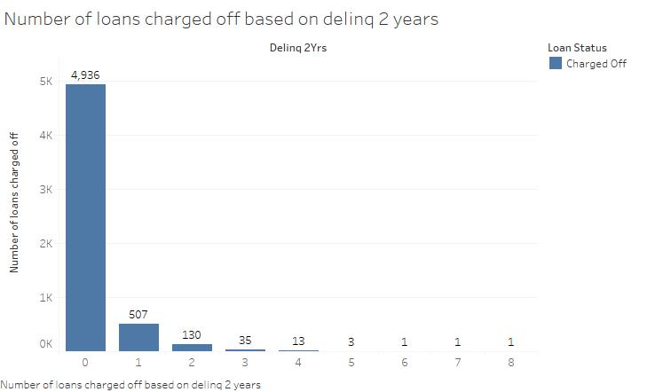
Number of loans charged off based on delinquency for PAST 2 Years
The adjacent graph shows the number of loans charged off based on delinquency.
The number of loans charged off are more in case of borrowers with zero 30+ days past-due incidences of delinquency for past two years

Slide 13
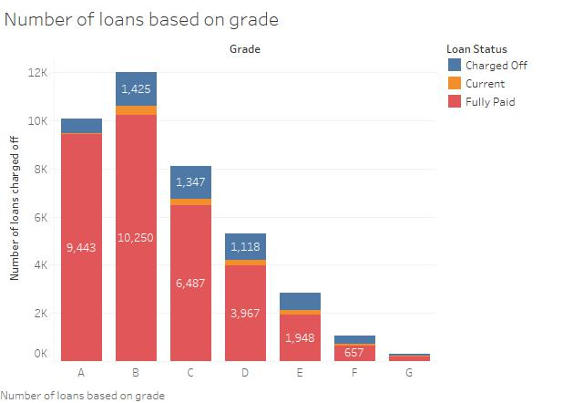
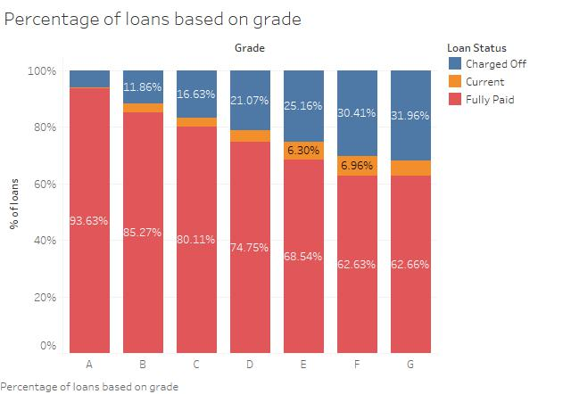
Number of loans BASED ON GRADE
It is evident from the below graph that the percentage of loans charged off is highly correlated with the grade.
On the scale of A to G loans with grade A are of low risk as the borrowers are most likely to repay the loan . The risk increases from A to G and the loans with grade G has the highest risk as the borrowers are unlikely to repay the loan.

Slide 14
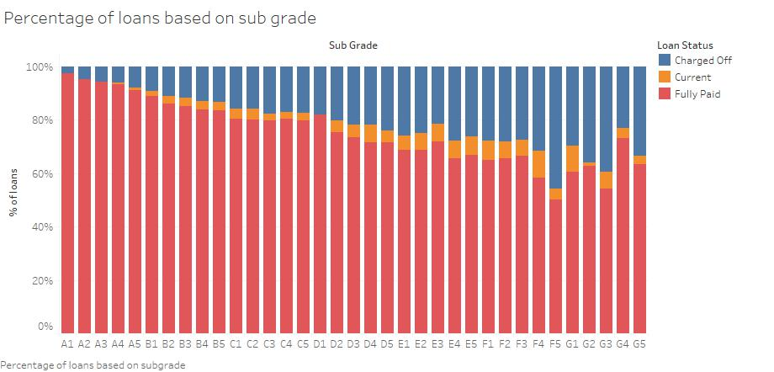
Number of loans BASED ON SUB GRADE
The percentage of loans charged off is also highly correlated with the sub grade.
On the scale of 1 to 5 within a grade, loans with sub grade 1 are at lower risk, as the borrowers are most likely to repay the loan . The risk increases from 1 to 5 and the loans with sub grade 5 within a grade are at highest risk as the borrowers are less likely to repay the loan.

Slide 15
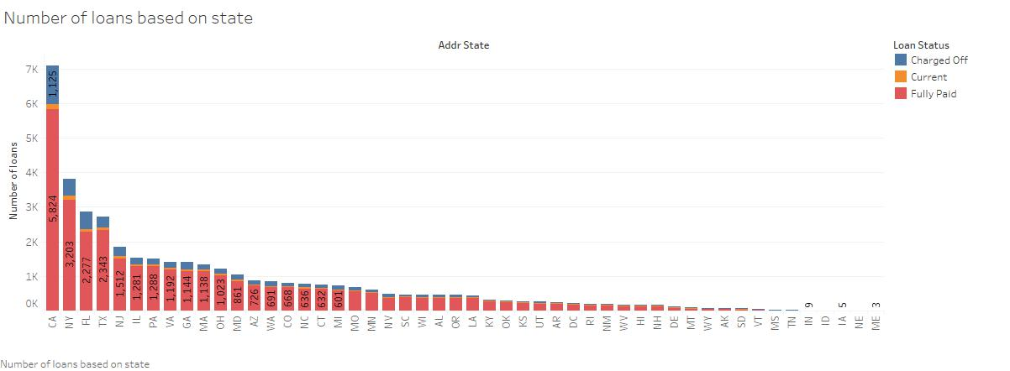
Number of loans BASED ON STATE
The number of loans borrowed are highest in the state CA, compared to all the other states.

Slide 16
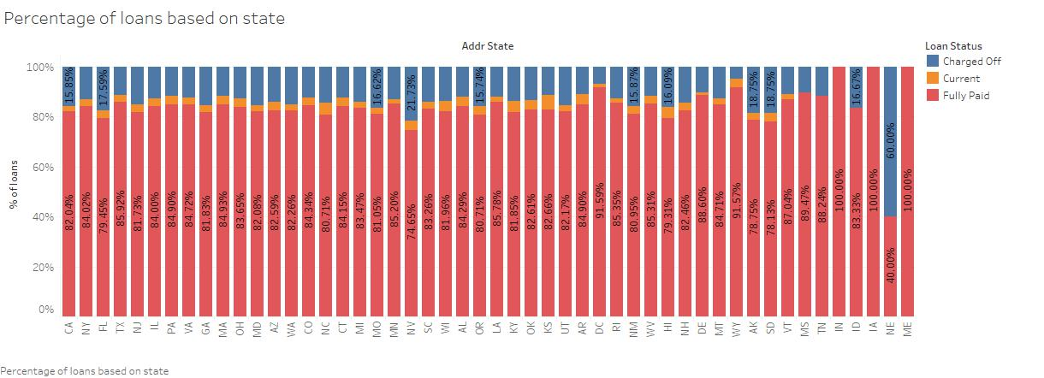
The percentage of loans charged off is highest in the state NE compared to all the other states.

Slide 17
Number of loans BASED ON STATE
The number of loans borrowed are highest in the state CA, compared to all the other states.

Slide 18
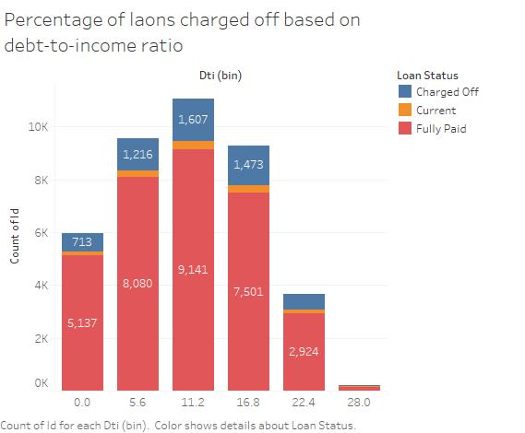
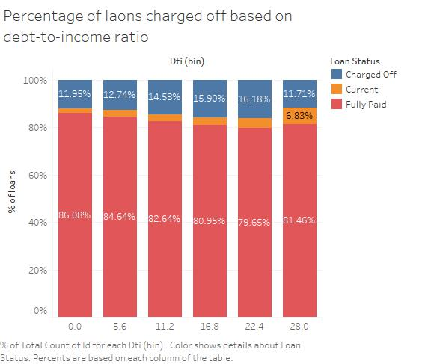
Number of loans BASED ON DTI
The number of loans charged off is more for the loans with DTI between 11.2 and 16.8
The percentage of loans charged off is highest for the loans with DTI between 22.4 and 28

Slide 19
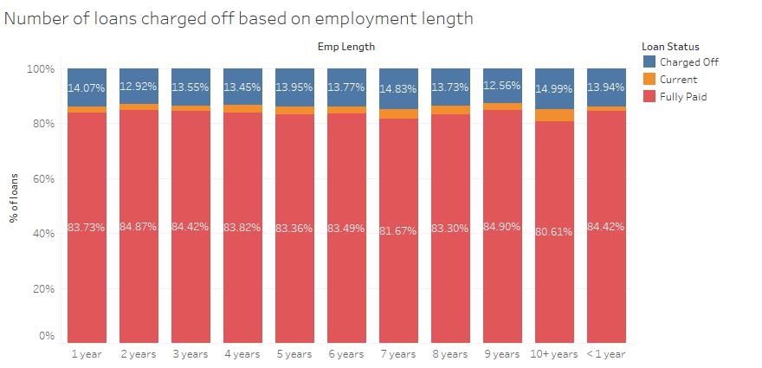
Number of loans BASED ON Employment length
There is no significant impact of employment length on the number of loans charged off

Slide 20
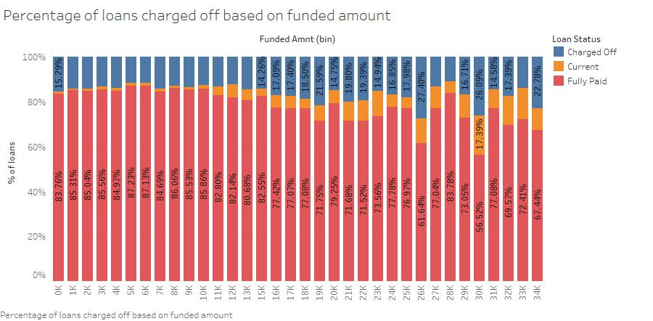
NUMBER OF LOANS BASED ON FUNDED AMOUNT

Slide 21
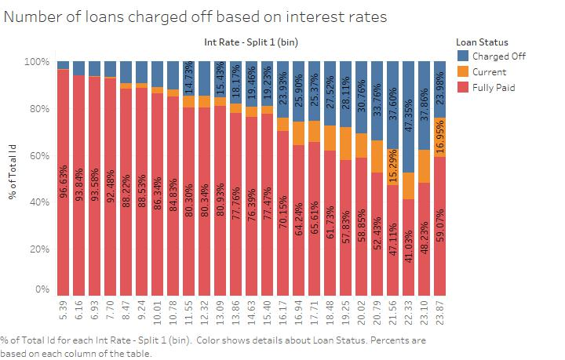
Number of loans BASED ON Interest rate
The percentage of loans charged off increased with the increase in the interest rate
The percentage of loans charged off is highest for the loans with the interest rates between 22.33 and 23.10

Slide 22
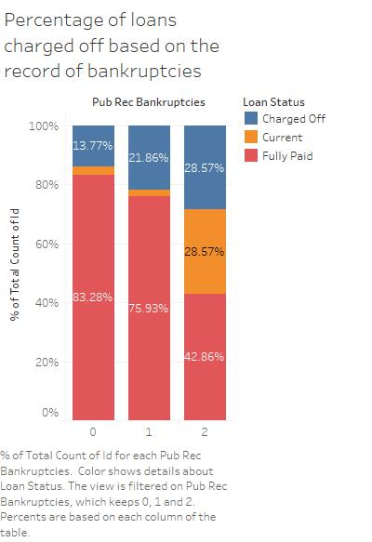
Percentage of loans charged off BASED ON record of bankruptcies
The percentage of loans charged off is highest for the loans taken by the borrowers with the record of more bankruptcies

Slide 23
Conclusion
The number of loans charged off is 5,627, which is around 14.16% of the total loans taken
The percentage of loans charged off is high in case of the loans with 60 months term
The percentage of loans charged off is highly correlated with the grade and sub grade.
The percentage of loans charged off increases with the increase in the interest rate
The percentage of loans charged off is highest for the loans with the interest rates between 22.33 and 23.10
The percentage of loans charged off is highest for the loans with DTI between 22.4 and 28
The percentage of loans charged off is highest for the loans taken by the borrowers with the record of more bankruptcies
The percentage of loans charged off is increases with the increase in the funded amount
The percentage of loans charged off is increases with the increase in the interest rate

Slide 24
THANK YOU

